Slide 1
AnyCubic i3 Mega Motherboard Reverse Engineering
© 2018 Rui Carneiro
Licensed under Apache License 2.0
Link: https://github.com/RuiCarneiro/ReverseEngineerTrigorillaPro

Slide 2
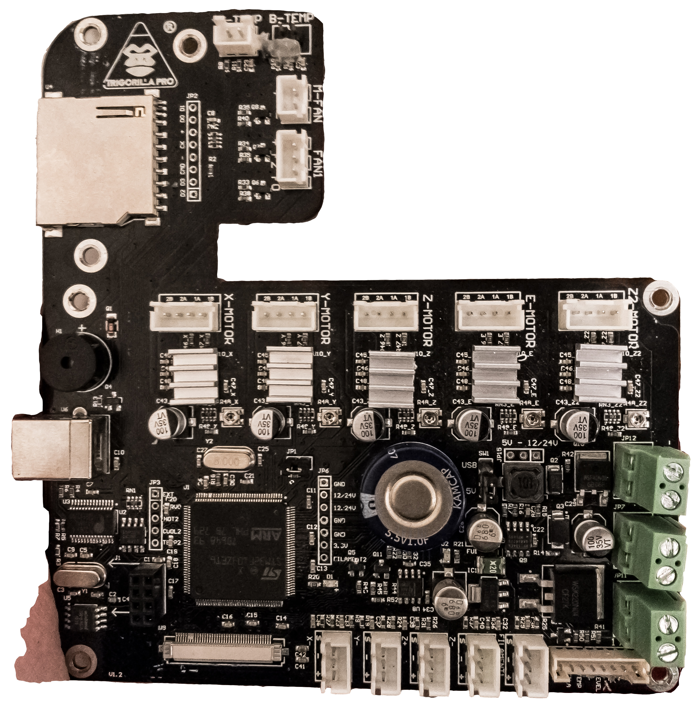
The board is held by 7 screws that appear to be M3
The holes are ⌀ 3.3mm

Slide 3
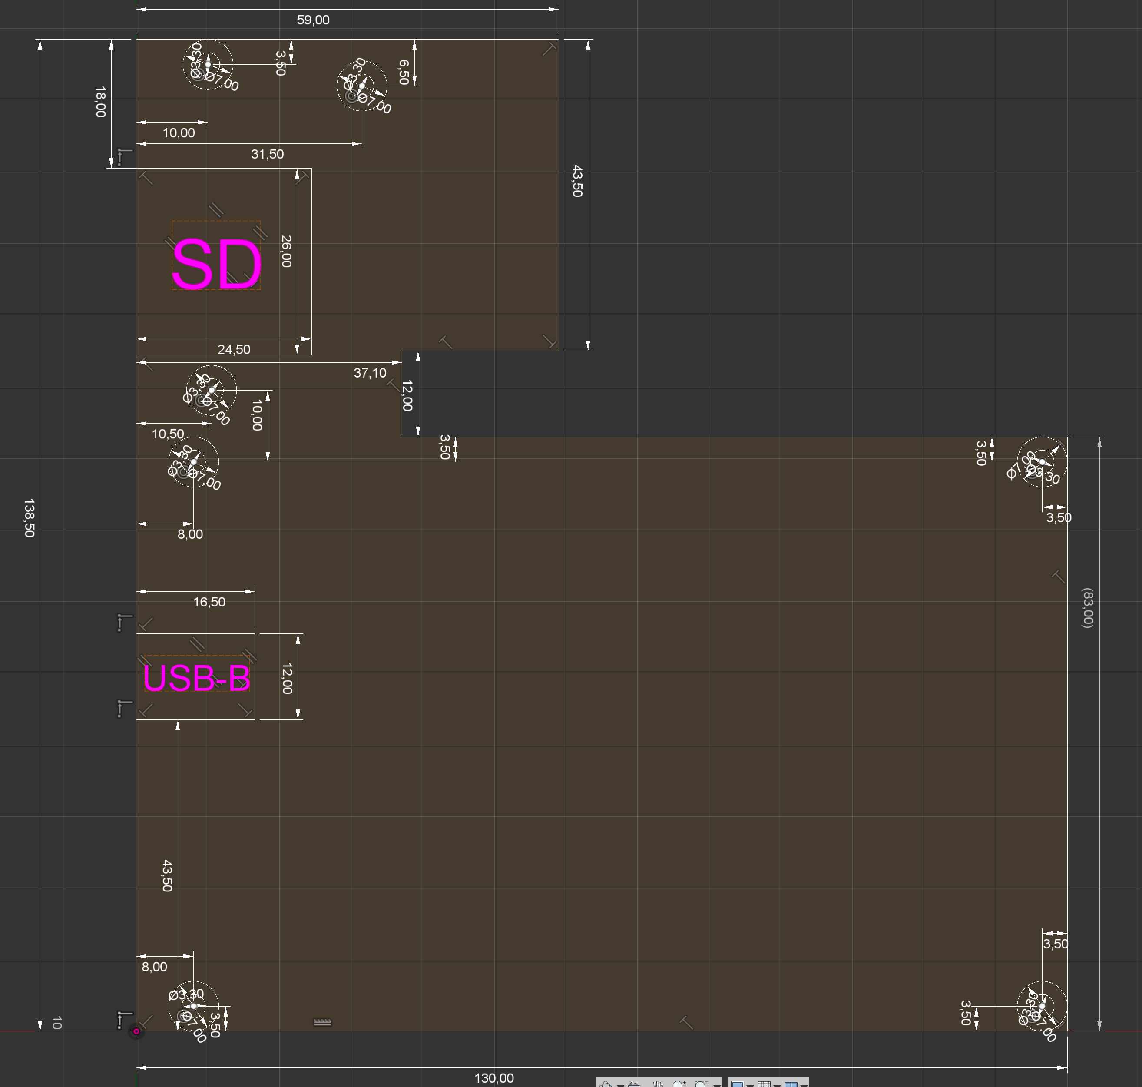
Here is the board plant, included in the .dxf file

Slide 4
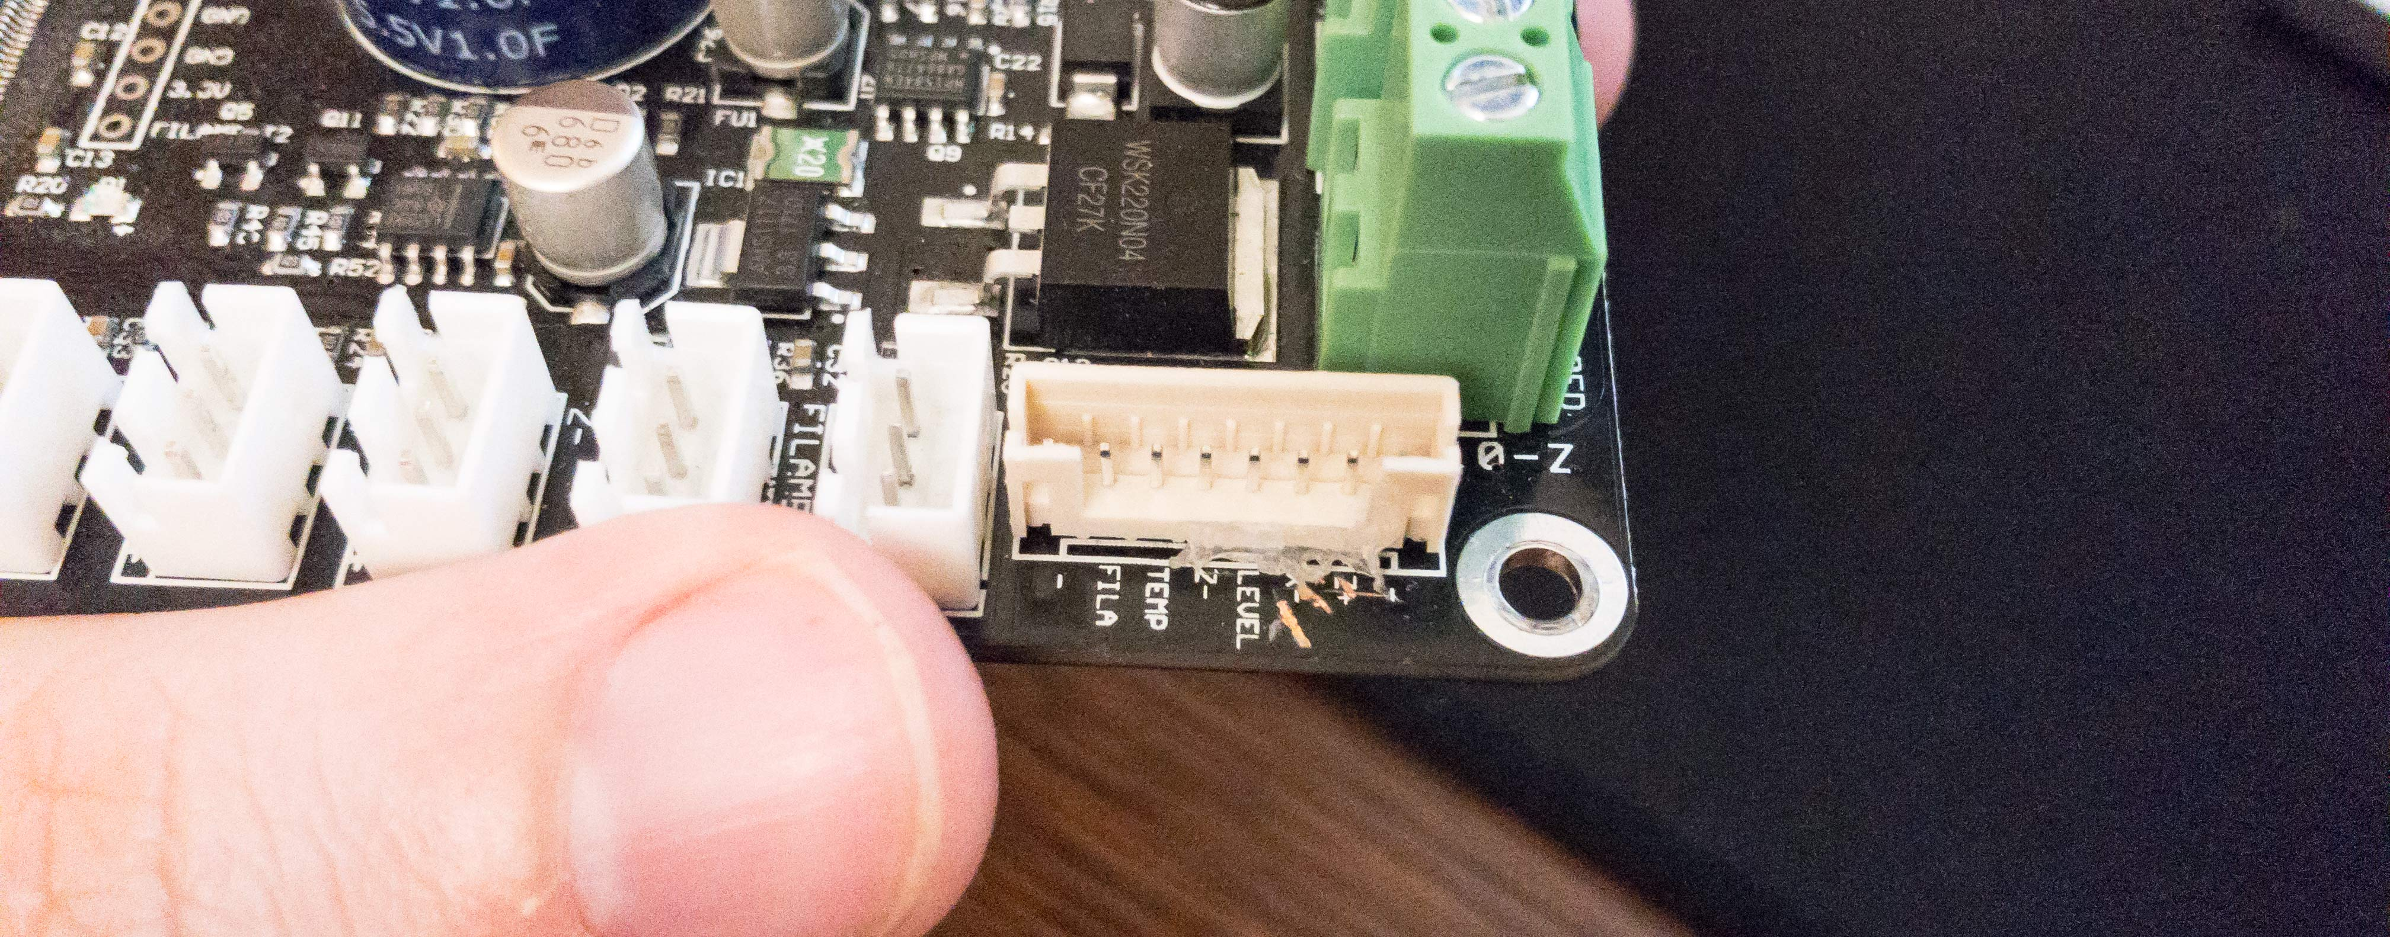
The ”SIGNAL” connector combines many signals into one connector.
Pins from LEFT to RIGHT (screw hole)
Colors corresponding to what I have on my board
GROUND
Filament Runout Sensor
Hotend Thermistor
Z-
“LEVEL”: don’t know what this is?
X-
Z+ (used for Z2?)
GROUND

Slide 5
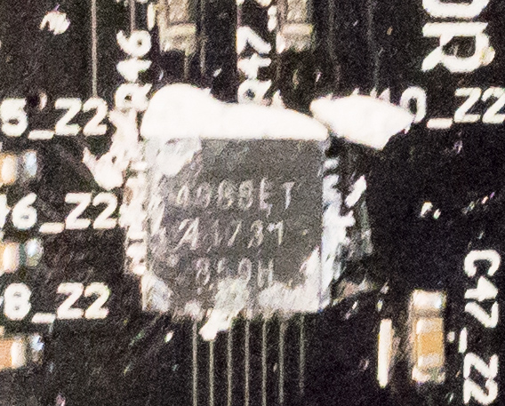
The stepper drivers appear to be the Allegro 4988ET
The heatsinks are glued very poorly, my printer is less than 1 month old, and they already came off without any effort.
User pauledd has replaced these with TMC2208’s, more at: https://github.com/RuiCarneiro/ReverseEngineerTrigorillaPro/issues/1

Slide 6
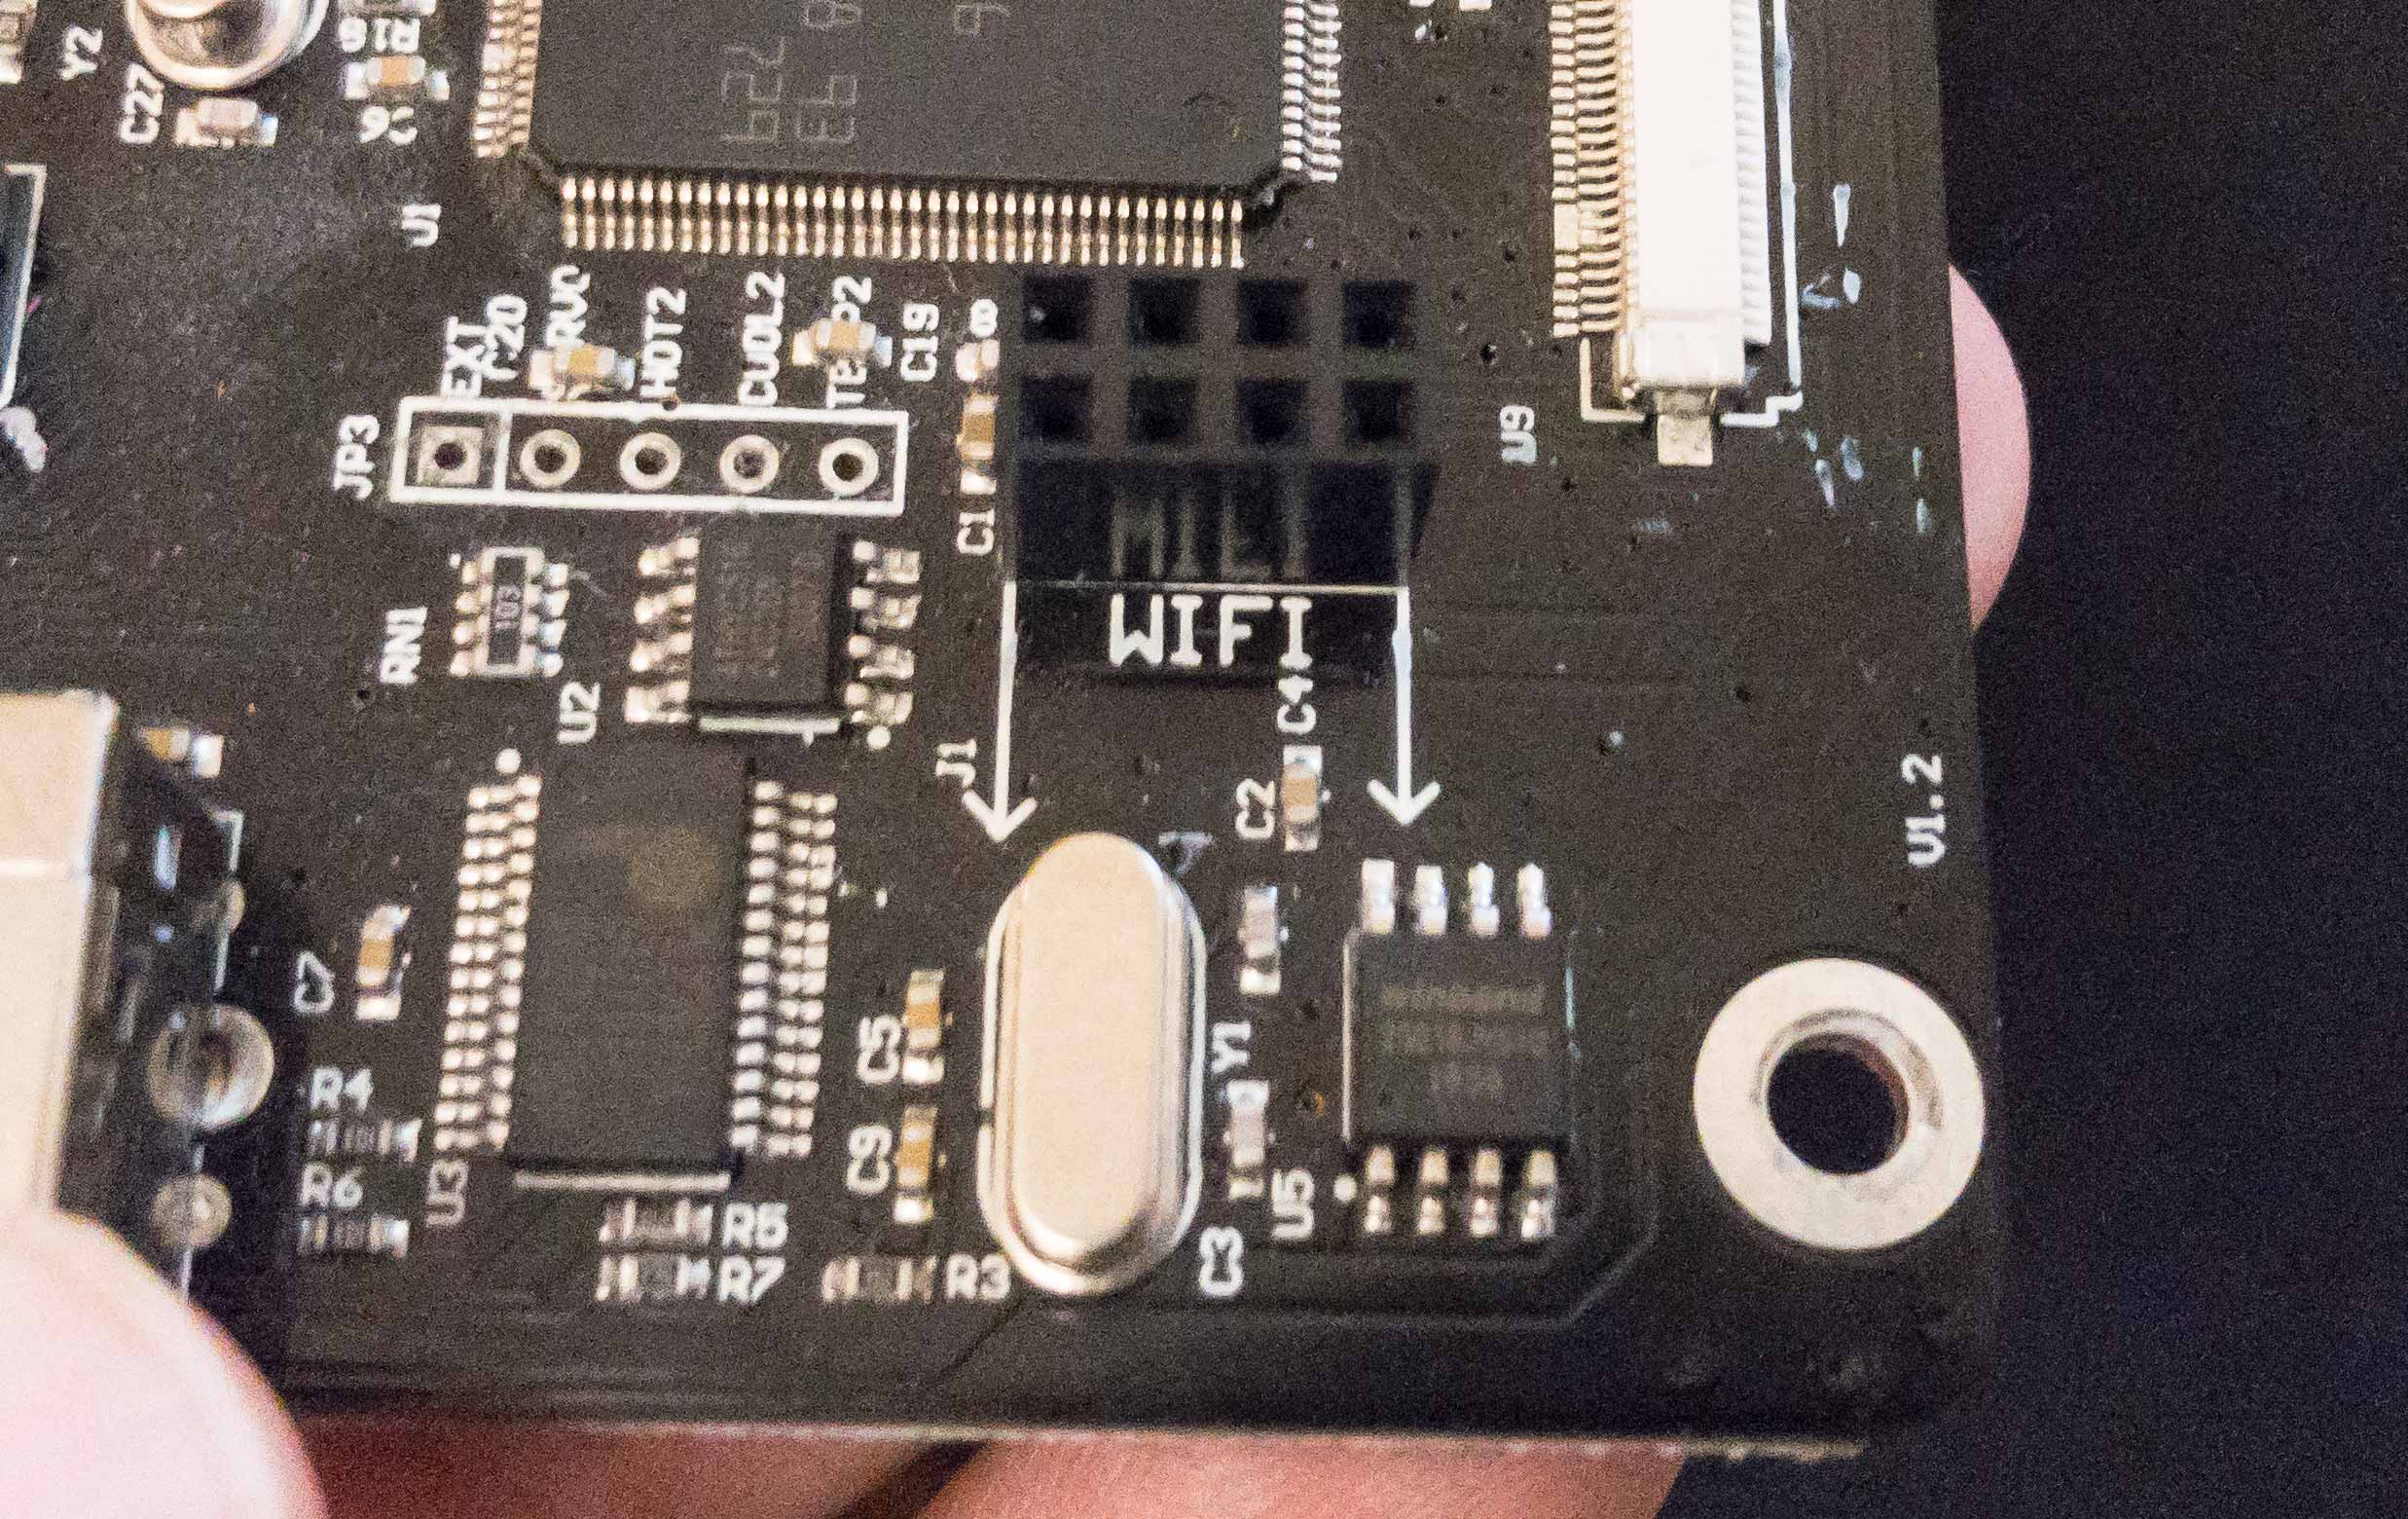
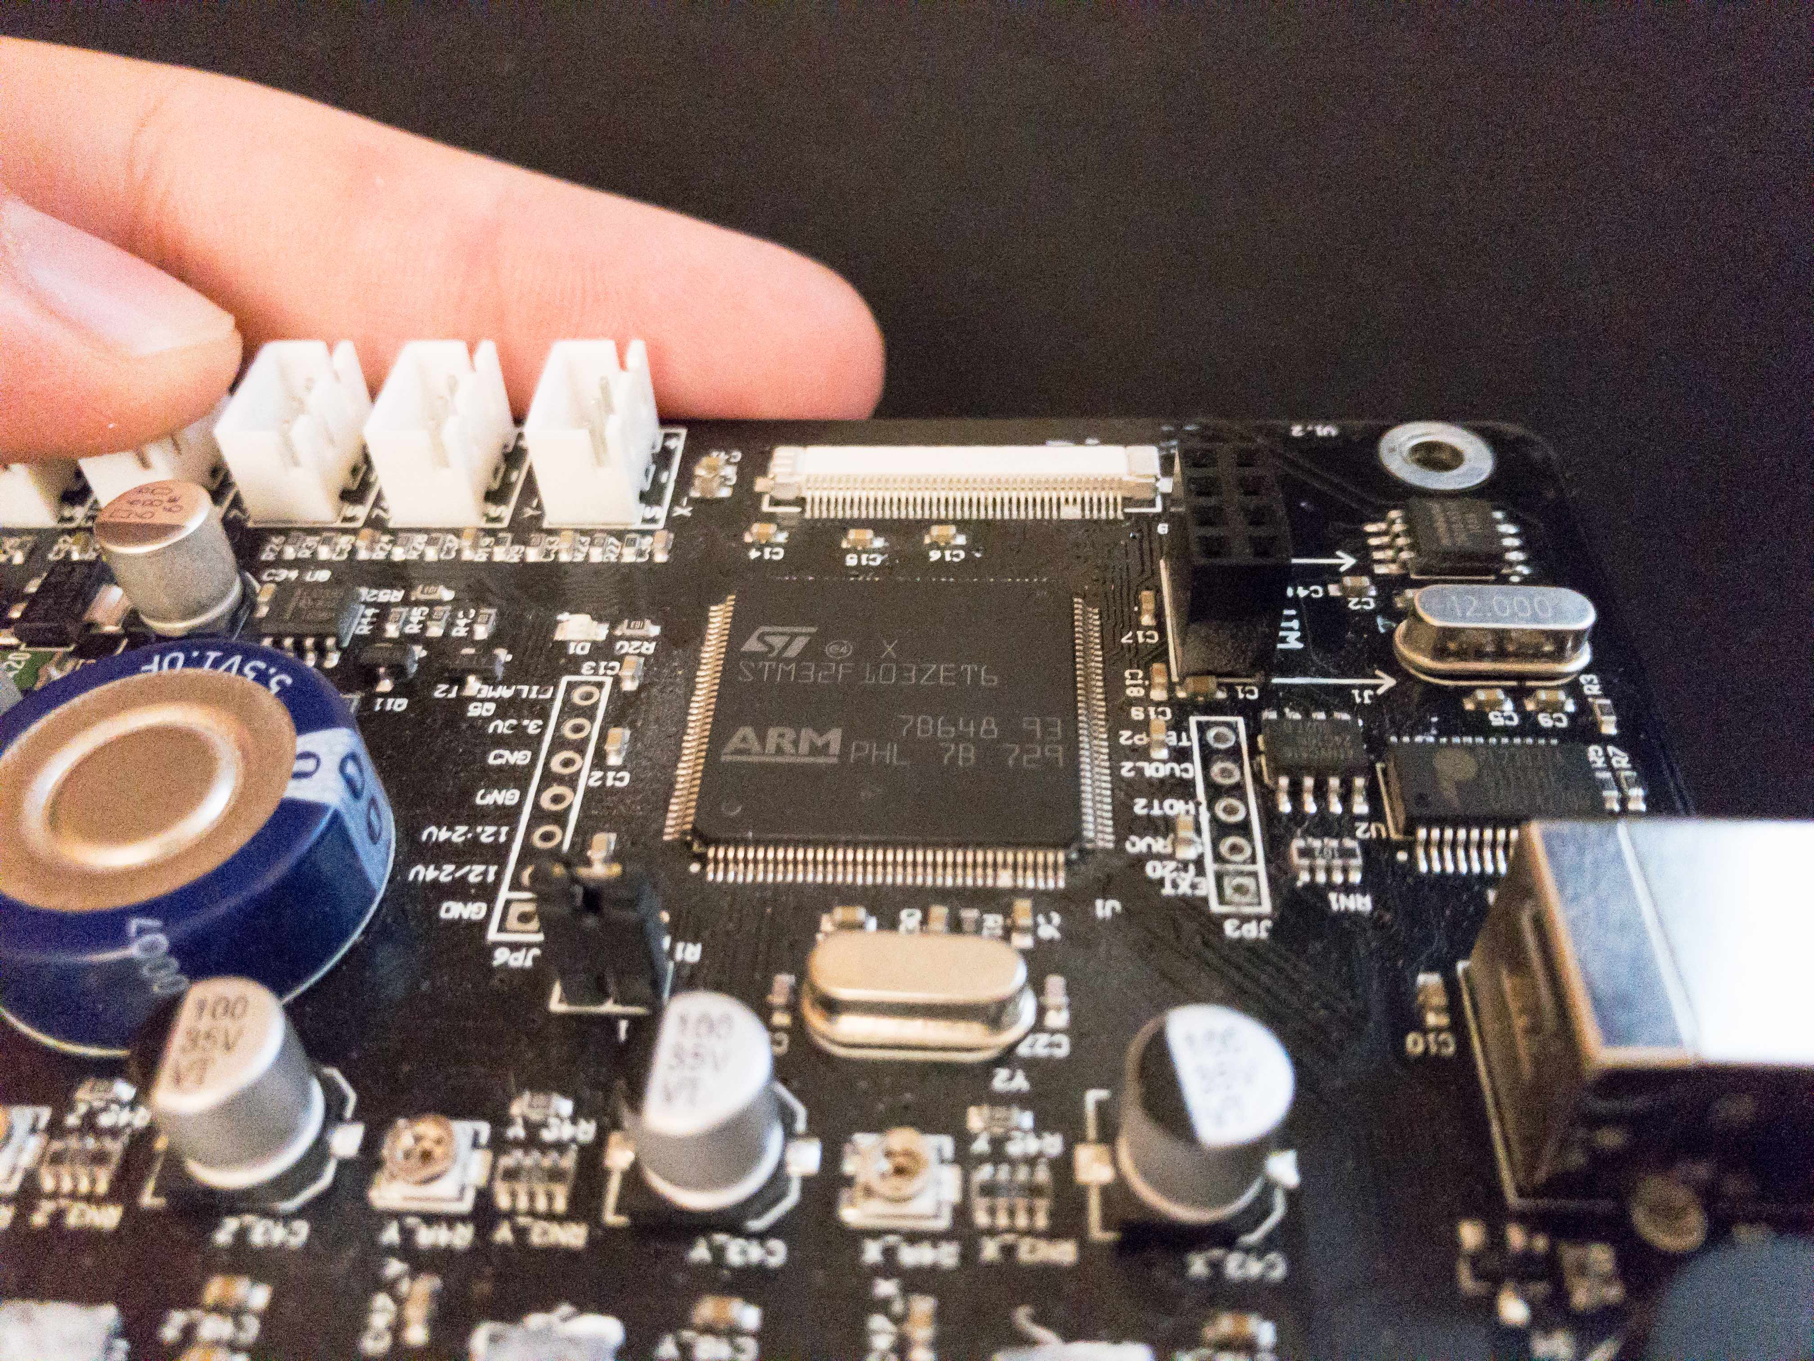
// Looks like they want to introduce WiFi
The CPU is a STM32F103ZET6
Single core ARM Cortex M3 at 72MHz
256 to 512KB of Flash
64KB of SRAM
// Supose it can do better microstepping than the AtMega 2560, but only 64KB of SRAM is too limiting!

Slide 7
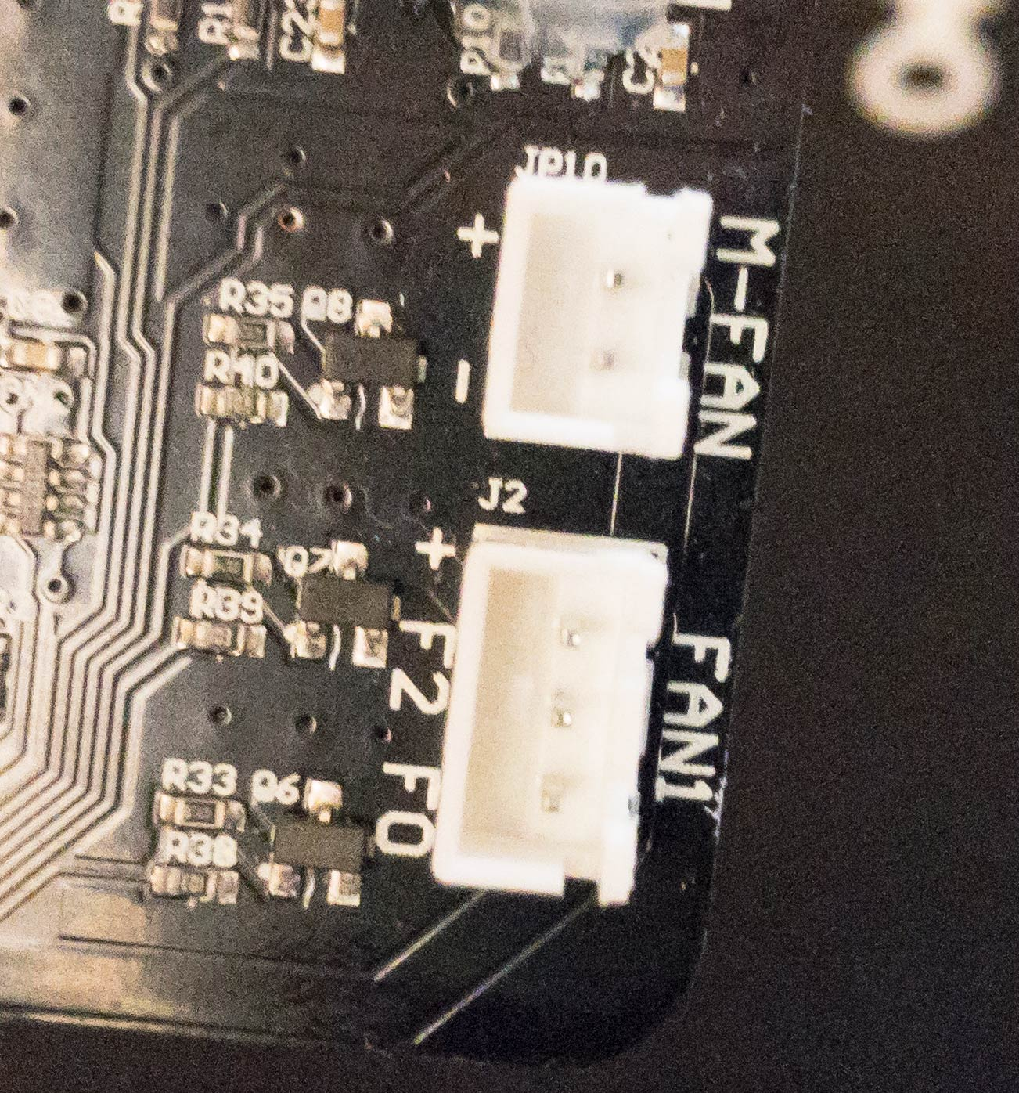
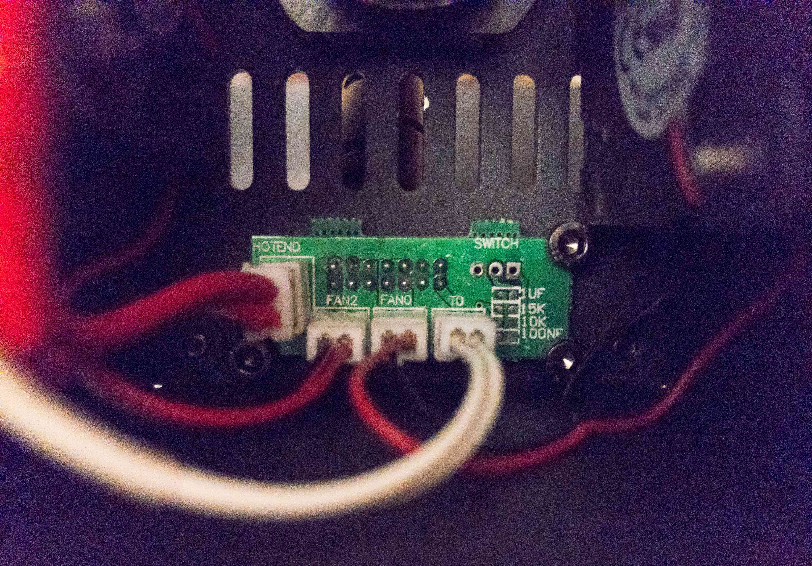
All fans in the machine are powered from these connectors
M-FAN is the motherboard FAN
FAN1 is no fan in specific, but it’s connected to the two fans carried in the tool-head
F2 is the part cooling fan
F0 is the hot-end (E3D V5 clone) cooling fan in the tool-head
Notice the three
little transistors
The M-FAN
Looks like it’s
Connected
To a CPU pin
Tool-head breakout board

Slide 8
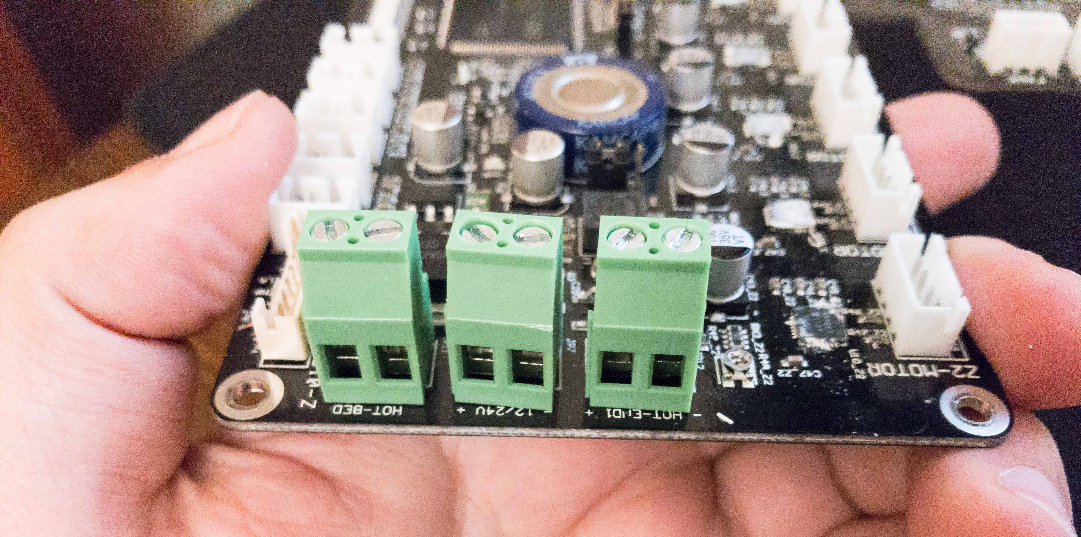
Connectors for high amperage outputs.
The power supply connector looks like it can receive 24V, but the product is currently sold with a 12V power supply and the hotbed is soldered to a 12V setting

